Slide 1


EMPLOYEE MANAGEMENT SYSTEM (EMS):
Subject CODE: 19CSE100
Subject Title: Problem Solving and Algorithmic Thinking
Group Number: 11
Team Members:
S. No | Name | Section
1 | ABHINAV S | CSE-D
2 | DEVA SUNDER S J | CSE-D
3 | KAUSALYAA SRI | CSE-D
4 | KISHORE KUMAR V S | CSE-D
4 | SUJITH ROSHAN N | CSE-D

Slide 2



Problem Definition
To design an Employee Management system to keep employee’s information like Attendance, Finance, Leave, Performance and Training record, etc., under some constraints/conditions such as:
Employee Management System (EMS) has two types of login.
Employee/User Login
Admin Login
Users can only access ‘User Login’ and Admins can access the ‘Admin Login’.

Slide 3


Analysing
Industries, especially large-scale industries, have exponentially grown in terms of the number of employees.
Many corporations find it difficult to manage the employee details in a traditional pen-paper way.
Problem: Find a way for industries to manage the employee details efficiently.
Goal: To create an Employee Management System!

Slide 4
Problem Decomposition
S. No | Sub problem Name | Description
1 | Levels | Split the management system into 2 levels
2 | Login | An interface to login to the employee management system
3 | User Panel features | Features that only ‘Users’ can access
4 | Admin Panel features | Features that only ‘Admins’ can access
5 | Logout | An interface to logout from the employee management system

Slide 5


Sub Problem 1 - Levels
Split the interface in two levels, i.e., such a way that it asks whether the employee is a ‘User’ or an ‘Admin’.
USER
ADMIN

Slide 6
Sub Problem 2 – Login
Allow the employee to login to the system. If the employee is a ‘User’ display the ‘User login Interface’ or if he/she is an ‘Admin’, display the ‘Admin login Interface’.

Slide 7
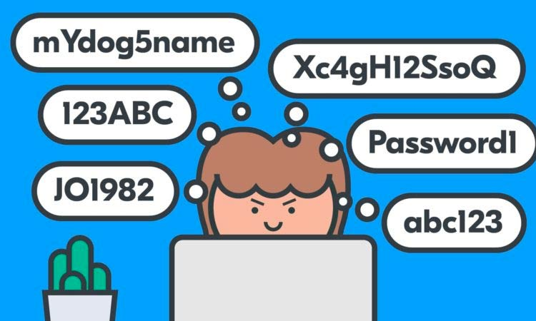
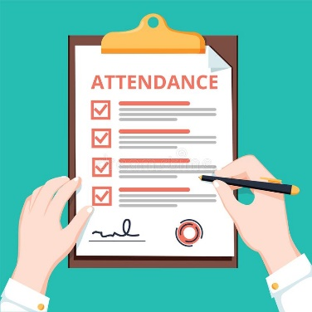

Sub Problem 3 – User panel features
Include features like login, update password, manage personal information, View salary, Manage Attendance, View Events, Manage Leave, Logout.
Update password
Manage Attendance
View Salary

Slide 8



Sub Problem 4 – Admin Panel features
Include features like login, add new user, manage employee personal information, manage employee finance, manage employee attendance, manage employee events, manage employee leave, manage employee training record, manage employee performance, Logout.
Add user
Manage Emp. Perf.
Manage Emp. leave

Slide 9

Sub Problem 5 - Logout
Provide an interface for all Users and Admins to logout from the system. Employees must logout to end their session.

Slide 10

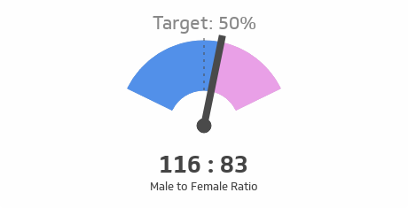
Abstraction
1. Male-Female ratio
The company uses this record for some data analysis on employee efficiency. User need not know about the record.
2. Total number of employee including every department:
A record of total number of people working for the company is kept to further analyze whether to extend the firm with existing employees or by recruiting new employees.

Slide 11

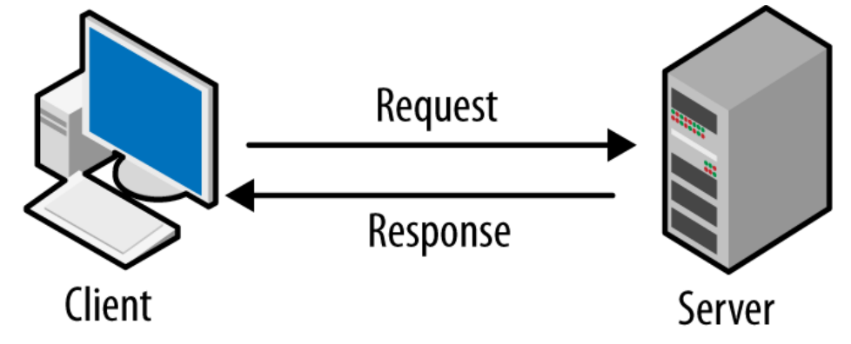
Abstraction
3. Database server
The user doesn’t know where his personal details and all other details regarding him are stored. He doesn’t have the right to access the database server. He won’t know anything about the data in the servers.

Slide 12


Abstraction
4. Employee Performance
Employee Performance record is maintained by the company and the employee doesn’t even know about this record. The record contains information on his contribution to company, attitude and character.
5. Training record
Whether the employee should be trained more? Or can he be made a team leader? The answers to these questions are based on the content in training record.

Slide 13
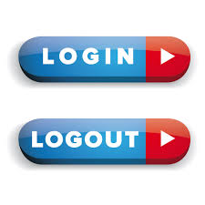


Pattern Recognition
The system follows specific pattern for both employee and admin login.
Only the administrative panel has the access to remove, add and edit employee information.
Employee has only access to view and edit.
Login & Logout
Admin:Remove,add,edit
Emp:Login & Logout

Slide 14

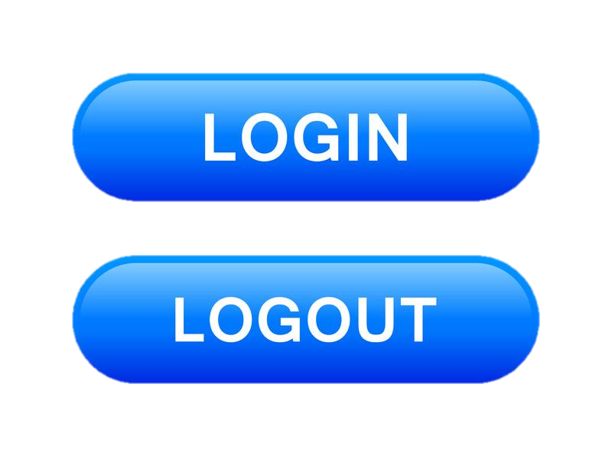

Pattern Recognition
The user also have permission to request leave and admin has permission to grant leave to the employees
The following are common in both the panels:
login
manage personal information
manage attendance (entry and exit)
log out
Personal information
Attendance
Login & Logout

Slide 15


Levels - Algorithm
The management system interface is divided into two major levels namely the Employee level and the Admin level.
The system displays both the levels such that it allows the user to choose between them.
Admin
Employee

Slide 16
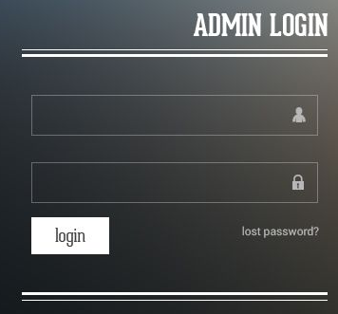
Login - Algorithm
The interface requires the user to choose how he has to login i.e., ‘The User’ or ‘The Admin’.
If ‘The User’ is chosen the User Login page opens allowing the user to enter his/her user ID and password.
Else if ‘The Admin is chosen the Admin Login page opens allowing the user to enter his/her user ID and password.
For the User Login the employee Id will be the user Id and a password that is pre-set for that particular ID has to be used.
Admin login page

Slide 17
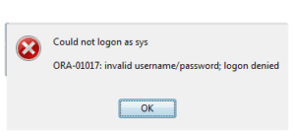
For the Admin Login the respective admin ID will be the
user ID and a password that is pre-set for that particular
ID has to be used.
All the set of IDs and password will be unique to each
user and is checked with the existing database to allow
the user to login to the system.
If the ID and password does not match, interface shows a
“wrong user id and password” message.
Invalid admin credentials

Slide 18

1.User Panel Features - Algorithm
The system displays a menu with many features for the user interface allowing the user to choose among them to access and update information and also to raise request.
Employee accessing the features through user interface

Slide 19

1.1 UPDATE PASSWORD
1.1 UPDATE PASSWORD-
1.1.1 The interface asks the user to enter the existing password.
1.1.2 Allows the user to enter the new password.
1.1.3 Asks the user to confirm the new password by
re entering it.
1.1.4 The new password is updated and shows a message as “Password
updated”
1.1.5 Back to menu
Employee being able to update his new password

Slide 20


1.2 MANAGE PERSONAL DETAILS
1.2 MANAGE PERSONAL DETAILS-
1.2.1 The system displays all the details of the user which is already
registered.
1.2.2 The interface allows the user to update any change in the personal
details like name, address, contact no. etc., in the respective
box/space given.
1.2.3 An icon named ‘Update’ will be displayed at the end of the page.
1.2.4 Once the changes are made the details will get updated upon clicking
on the update icon and displays a message as “Details Updated”.
1.2.5 Back to menu.

Slide 21
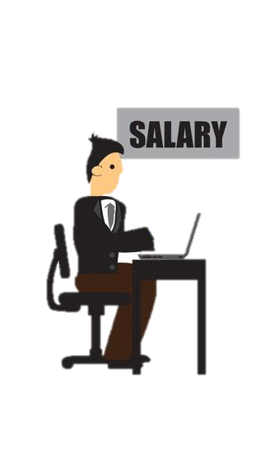

1.3 VIEW SALARY
1.3 VIEW SALARY-
1.3.1 Shows sub features like Payments and Deduction,
Net salary a Duration.
1.3.2 Payment and deduction show the salary payment and deductions
made in the salary along with the date, time and stating the reason
for deduction in payment if any.
1.3.3 Net salary shows the users salary details including his/her net salary
amount and allowance like HRA and DA.
1.3.4 Duration shows the working hours of the person.
1.3.5 Back to menu

Slide 22

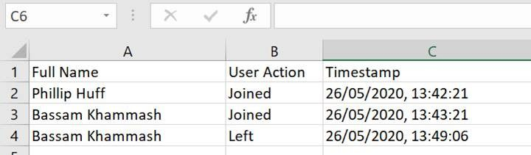
1.4 MANAGE ATTENDENCE
1.4 MANAGE ATTENDENCE-
1.4.1 Displays the attendance details month wise in a tabular form indicating date, day, Entry Time and Exit time.
1.4.2 Back to menu
Sample attendance record

Slide 23


1.5 VIEW EVENTS
1.5 VIEW EVENTS-
1.5.1 Displays the calendar showing details like time, date and
description on official events like meetings, training
programs, product launch events, get-togethers etc.
1.5.2 Back to menu.

Slide 24
1.6 MANAGE LEAVE
1.6 MANAGE LEAVE-
1.6.1 Displays the details in calendar format showing holidays, On Duty and leaves taken month wise.
1.6.2 Shows an option to request for a leave and allows the user to state the reason and duration of leave.
1.6.3 Once the request is raised, the interface also shows a data
on number of leaves allowed per year, number of leave
taken so far, remaining number of leaves and also shows a
warning message if the leaves allotted per year was already
used.
1.6.4 Back to menu.

Slide 25


2.Admin Panel Features - Algorithm
The system displays a menu with many features of the admin interface allowing the admin to manage and support various information of the employees

Slide 26


2.1 ADD NEW USER
2.1 ADD NEW USER-
2.1.1 The system allows the admin to fill in details of new user (employee) to create a new login.
2.1.2 once the profile is created message is shown that ‘new user added’.
2.1.3 Back to menu

Slide 27


2.2 MANAGE EMPLOYEE PERSONAL DETAILS
2.2 MANGE EMPLOYEE PERSONAL DETAILS-
2.2.1 Displays three sub features like Add, Remove or
Edit details.
2.2.2 allows the admin to make any changes in the
employee details if required.
2.2.3 Back to menu.

Slide 28
2.3 MANAGE EMPLOYEE FINANCE
2.3 MANAGE EMPLOYEE FINANCE-
2.3.1 Displays features like Allowance, Advance/Due and Loan.
2.3.2 In Allowance the admin is allowed to update or make changes in the different allowance amounts allotted to any employee.
2.3.3 Advance/due feature displays the details of any advance or due
amount of each employee and allows admin to change or cancel any
dues paid.
2.3.4 Loan feature displays the details on the loans availed by an employee
that contains the amount, duration, interest rate, bank/organization
details etc., in a sequential order.

Slide 29


2.3.5 A check box feature is given in the interface that
allows the admin to check or manage all the financial
features of one particular employee by entering the
employee id.
2.3.6 The interface also allows the admin to send any alert
messages to an employee in case of any nearing due
dates.
2.3.7 Back to menu.

Slide 30

2.4 MANAGE EMPLOYEE ATTENDANCE
2.4 MANAGE EMPLOYEE ATTENDANCE-
2.4.1 Allows the admin to enter and change the entry and exit timings date wise for each employee.
2.4.2 Back to menu.

Slide 31
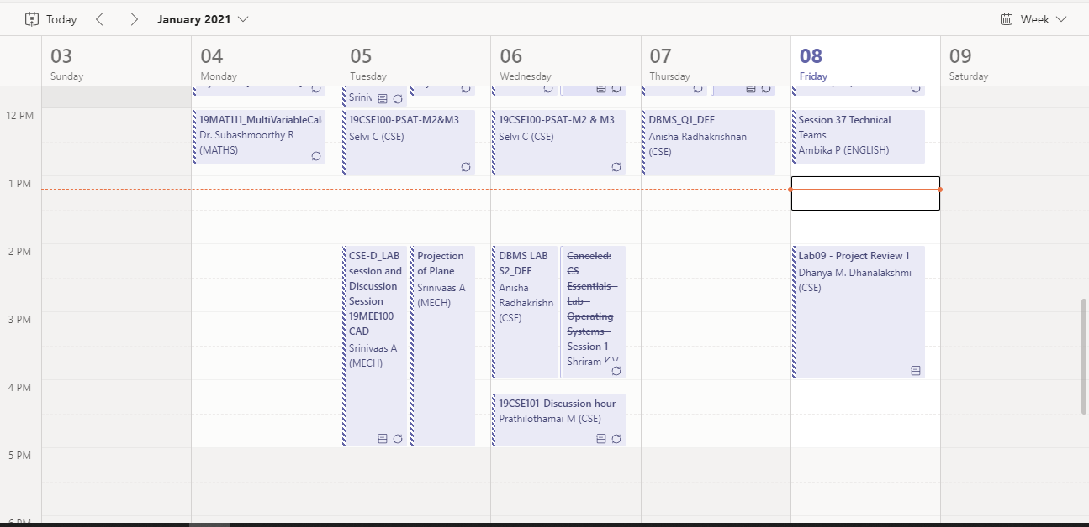
2.5 MANAGE EMPLOYEE EVENTS
2.5 MANAGE EMPLOYEE EVENTS-
2.5.1 Allows the admin to change or update any official event timing, date and description in the scheduled calendar.
2.5.2 Back to menu.

Slide 32
2.6 MANAGE EMPLOYEE LEAVE
2.6 MANAGE EMPLOYEE LEAVE-
2.6.1 It displays all the leave request raised by the employees allowing the admin to either grant or decline the request stating the reason for the same.
2.6.2 Interface also allows the admin to allot the total number of leaves allowed per year for a particular employee and calculate the number of leaves used and remaining.
2.6.3 An alert message can be raised to the employee if he/she has used all the allotted leaves or has reached a particular limit.
2.6.4 Back to menu.

Slide 33


2.7 MANAGE EMPLOYEE TRAINING RECORD
2.7 MANAGE EMPLOYEE TRAINING RECORD-
2.7.1 displays the duration of training period of each employee and their performance during the training period.
2.7.2 New training records can be added, removed and modified.
2.7.3 Back to menu.

Slide 34

2.8 MANAGE EMPLOYEE PERFORMANCE
2.8 MANAGE EMPLOYEE PERFORMANCE
2.8.1 displays work history and performance remarks of each employee.
2.8.2 admin can analyze and calculate promotion dates based on work history and performance
2.8.3 messages can be sent to employees as a token of appreciation for better performances and also to warn them in case of decline in performance.
2.8.4 Back to menu

Slide 35


LOGOUT ALGORITHM
A logout icon will be displayed on the interface for both the user and the admin.
Upon clicking it the session ends.

Slide 36
THANK YOU
Abhinav S
Deva Sunder SJ​
Kishore Kumar V S​
Kausalyaa Sri​
Sujith Roshan N

